Slide 1
Relations on a Set: Transitivity and Digraphs
Fall 2023
CS 236

Slide 2
Overview and Due
Topics:
Graph representation of a relation on a set
Symmetry and Reflexivity
Transitivity
Note: 3 Blue 1 Brown video is linked next Wednesday’s course content
Due
Project 3 due yesterday
HW 17 due Monday
HW 18a and 18b due Wednesday
HW 19 and 20 due Friday

Slide 3
Big Picture
Relations
Binary Relations
Relations on a Set
Equivalence Relations
Definition 2 Section 9.3.3:
A relation on a set A is a (binary)
relation from A to A
Greater Than
A | A
3 | 1
2 | 1
3 | 2
4 | 3
4 | 2
4 | 1

Slide 4
Big Picture
Relations
Binary Relations
Relations on a Set
Equivalence Relations
An equivalence relation “acts” like “equal to”
Reflexive
Symmetric
Transitive

Slide 5
Application of Lecture Concepts

Slide 6
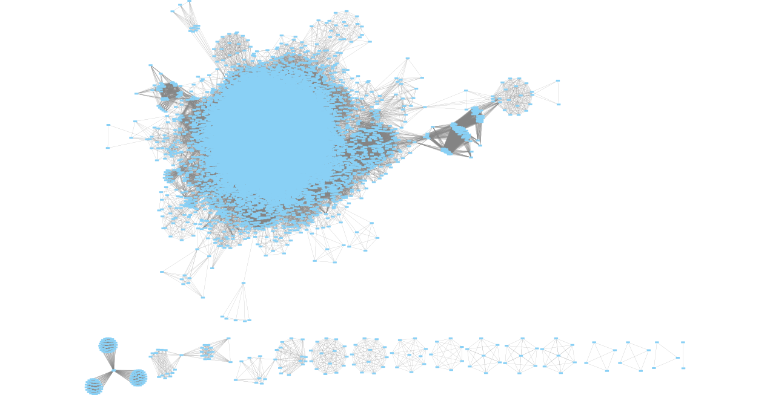
Application
Graph of who shares a class with whom for Winter 2020

Slide 7
Application
if a can infect b and
if b can infect c
then a can infect c
Could I be the disease vector
to someone vulnerable
Graph of who shares a class with whom for Winter 2020

Slide 8
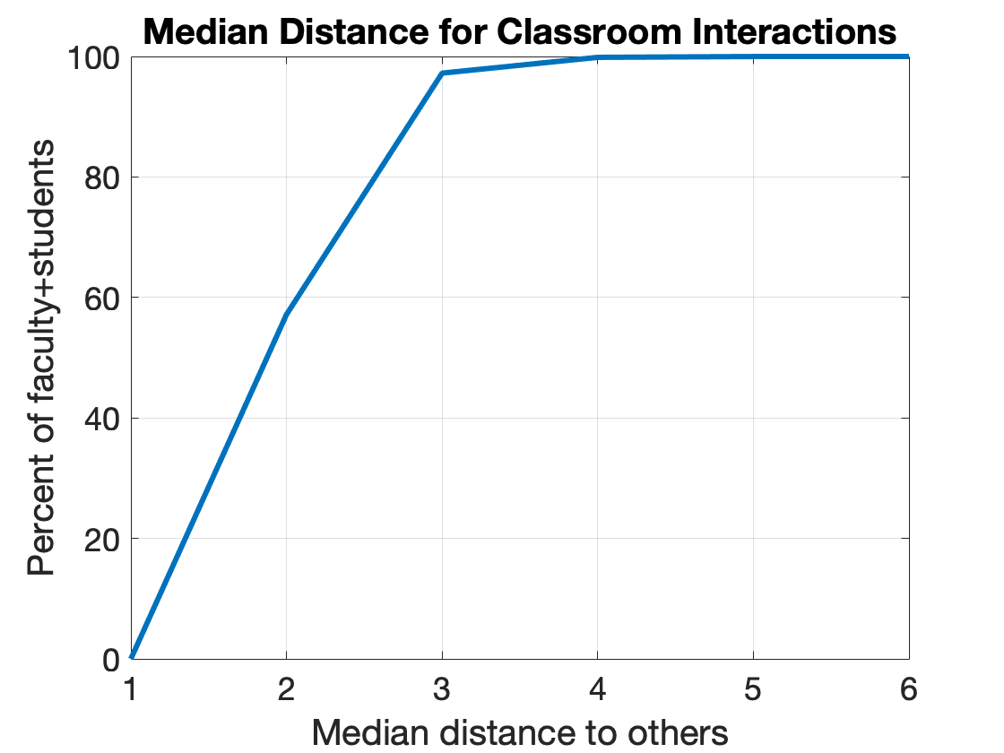
Application
If infectious, 95% of BYU students and faculty could spread the disease to half the BYU population in three incubation periods

Slide 9
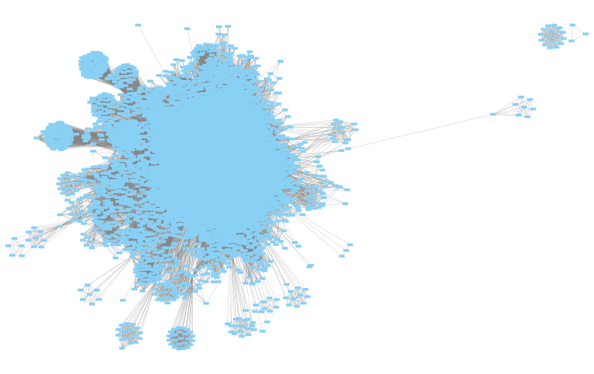
Application
The maximum distance between agents is called the graph diameter
Diameter(G) = 8
No faculty member or student is more than 8 classrooms from all other faculty members and students
Except for “one-off” classes
8
“one-off” class

Slide 10
Application
By computing the transitive closure
of the InSameClassAs(a,b) relation,
we learn that nearly 100% of the
BYU community is connected to
every other member of the BYU
community through classrooms
The maximum distance between agents is called the graph diameter
Diameter(G) = 8
No faculty member or student is more than 8 classrooms from all other faculty members and students
Except for “one-off” classes
8
“one-off” class

Slide 11
Representing relations on a set using graphs

Slide 12
Representing Relation: Table, Set, Matrix, Graph
Let R denote the relation “greater than” over A={1,2,3,4}
R={(4,1),(4,2),(4,3),(3,1),(3,2),(2,1)}
M_{R}
A | A
3 | 1
2 | 1
3 | 2
4 | 3
4 | 2
4 | 1
Notes:
LaTeX for matrix: \left[ \begin{array}{llll}
& \ \ & \ \ & \ \ \\
& \ \ & \ \ & \ \ \\
& \ \ & \ \ & \ \ \\
& \ \ & \ \ & \ \
\end{array} \right]

Slide 13
Representing Relation: Table, Set, Matrix, Graph
Let R denote the relation “greater than” over A={1,2,3,4}
R={(4,1),(4,2),(4,3),(3,1),(3,2),(2,1)}
M_{R}
Directed Graph (digraph): Set of vertices V and set of edges E that connect vertices. (Def 1 section 9.3.3)
Notes:
LaTeX for matrix: \left[ \begin{array}{llll}
& \ \ & \ \ & \ \ \\
& \ \ & \ \ & \ \ \\
& \ \ & \ \ & \ \ \\
& \ \ & \ \ & \ \
\end{array} \right]

Slide 14
Representing Relation: Table, Set, Matrix, Graph
Let R denote the relation “greater than” over A={1,2,3,4}
R={(4,1),(4,2),(4,3),(3,1),(3,2),(2,1)}
M_{R}
Directed Graph (digraph): Set of vertices V and set of edges E that connect vertices. (Def 1 section 9.3.3)
Let the vertices be the set A and the edges be the ordered pairs in R
Notes:
LaTeX for matrix: \left[ \begin{array}{llll}
& \ \ & \ \ & \ \ \\
& \ \ & \ \ & \ \ \\
& \ \ & \ \ & \ \ \\
& \ \ & \ \ & \ \
\end{array} \right]

Slide 15
Representing Relation: Table, Set, Matrix, Graph
R={(4,1),(4,2),(4,3),(3,1),(3,2),(2,1)}
A={1,2,3,4}
M_{R}
Let the vertices be the set A and the edges be the ordered pairs in R
1
2
4
3
Notes:
LaTeX for matrix: \left[ \begin{array}{llll}
& \ \ & \ \ & \ \ \\
& \ \ & \ \ & \ \ \\
& \ \ & \ \ & \ \ \\
& \ \ & \ \ & \ \
\end{array} \right]

Slide 16
Representing Relation: Table, Set, Matrix, Graph
R={(4,1),(4,2),(4,3),(3,1),(3,2),(2,1)}
A={1,2,3,4}
M_{R}
Let the vertices be the set A and the edges be the ordered pairs in R
1
2
4
3
order in (4,1) means arrow starts at vertex 4 and ends at vertex 1
Notes:
LaTeX for matrix: \left[ \begin{array}{llll}
& \ \ & \ \ & \ \ \\
& \ \ & \ \ & \ \ \\
& \ \ & \ \ & \ \ \\
& \ \ & \ \ & \ \
\end{array} \right]

Slide 17
Representing Relation: Table, Set, Matrix, Graph
R={(4,1),(4,2),(4,3),(3,1),(3,2),(2,1)}
M_{R}
Let the vertices be the set A and the edges be the ordered pairs in R
1
2
4
3
Complete the graph
Notes:
LaTeX for matrix: \left[ \begin{array}{llll}
& \ \ & \ \ & \ \ \\
& \ \ & \ \ & \ \ \\
& \ \ & \ \ & \ \ \\
& \ \ & \ \ & \ \
\end{array} \right]

Slide 18
Representing Relation: Table, Set, Matrix, Graph
R={(4,1),(4,2),(4,3),(3,1),(3,2),(2,1)}
M_{R}
Let the vertices be the set A and the edges be the ordered pairs in R
1
2
4
3
Notes:
LaTeX for matrix: \left[ \begin{array}{llll}
& \ \ & \ \ & \ \ \\
& \ \ & \ \ & \ \ \\
& \ \ & \ \ & \ \ \\
& \ \ & \ \ & \ \
\end{array} \right]

Slide 19
What does the Reflexive Property Look Like on a Graph?

Slide 20
Big Picture
Relations
Binary Relations
Relations on a Set
Equivalence Relations
An equivalence relation “acts” like “equal to”
Reflexive
Symmetric
Transitive
We want to know what these properties
look like for matrix and graph representations
of relations

Slide 21
Reflexive?
M_{R1}
1
2
4
3
See Definition 3 in Section 9.1.4

Slide 22
Reflexive?
M_{R1}
1
2
4
3
Yes!
Matrix: 1’s on the diagonal
Graph: self loops on all vertices
See Definition 3 in Section 9.1.4

Slide 23
Reflexive?
M_{R2}
1
2
4
3
See Definition 3 in Section 9.1.4

Slide 24
Reflexive?
M_{R2}
1
2
4
3
No!
Matrix: 0’s on the diagonal
Graph: not self loops on all vertices
See Definition 3 in Section 9.1.4

Slide 25
Make this reflexive
M_{R2}
1
2
4
3
for each a
add edge (a,a)
See Definition 3 in Section 9.1.4

Slide 26
Make this reflexive
M_{R2}
See Definition 3 in Section 9.1.4

Slide 27
What does the Symmetry Property Look Like on a Graph?

Slide 28
Symmetric?
M_{R3}
1
2
4
3
See Definition 4 in Section 9.1.4

Slide 29
Symmetric?
M_{R3}
1
2
4
3
No!
Matrix: 1 at (3,1) but not at (1,3)
Graph: not arrows in both directions 3<-->1
See Definition 4 in Section 9.1.4

Slide 30
Symmetric?
M_{R3}
1
1
2
4
3
Fix:
If there is an edge one direction, then
there must be an edge in the other direction
See Definition 4 in Section 9.1.4

Slide 31
Symmetric?
M_{R4}
1
2
4
3
See Definition 4 in Section 9.1.4

Slide 32
Symmetric?
M_{R4}
1
2
4
3
Yes!
Matrix: 1 at (j,k) and at(k,j)
Graph: arrows in both directions between j and k
See Definition 4 in Section 9.1.4

Slide 33
Symmetric?
M_{R4}
1
2
4
3
Yes!
Matrix: 1 at (j,k) and at(k,j)
Graph: arrows in both directions between j and k
See Definition 4 in Section 9.1.4

Slide 34
Make this relation symmetric
M_{R5}
1
2
4
3
if there is an edge from a to b
and an edge from b to 1
for each a
for each b
if (a,b) then add (b,a)

Slide 35
Make this relation symmetric
sym(M_{R5})
1
1
2
1
1
4
3
if there is an edge from a to b
and an edge from b to 1
for each a
for each b
if (a,b) then add (b,a)

Slide 36
Make this relation symmetric
M_{R5}
M_{R5}^{T}
Make the columns the rows

Slide 37
Make this relation symmetric
M_{R5}
sym(M_{R5})
M_{R5}^{T}
Make the columns the rows

Slide 38
Transitivity

Slide 39
Transitive?
If a is related to b,
and if b is related to c
then a is related to c
See Definition 5 in Section 9.1.4

Slide 40
Transitive?
You’ve seen something like this before
a>b and b>c means a>c
If a is related to b,
and if b is related to c
then a is related to c
See Definition 5 in Section 9.1.4

Slide 41
Transitive?
M_{R5}
1
2
4
3
If a is related to b,
and if b is related to c
then a is related to c
See Definition 5 in Section 9.1.4

Slide 42
Transitive?
M_{R5}
1
2
4
3
No! Consider a=4, b=1, c=4
See Definition 5 in Section 9.1.4

Slide 43
Transitive?
(a,b)
M_{R5}
1
2
4
3
No! Consider a=4, b=1, c=4
See Definition 5 in Section 9.1.4

Slide 44
Transitive?
(a,b)
(b,c)
M_{R5}
1
2
4
3
No! Consider a=4, b=1, c=4
See Definition 5 in Section 9.1.4

Slide 45
Transitive?
(a,b)
(b,c)
(a,c)
M_{R5}
1
2
4
3
No! Consider a=4, b=1, c=4
See Definition 5 in Section 9.1.4

Slide 46
Transitive?
(a,b)
(b,c)
(a,c)
M_{R5}
1
2
4
3
No! Consider a=4, b=1, c=4
Tracking transitivity by hand is difficult.
We’ll need an algorithm to do it efficiently.
See Definition 5 in Section 9.1.4

Slide 47
Make this relation transitive
M_{R5}
1
2
4
3
if there is an edge from a to b
and an edge from b to c
add an edge from a to c

Slide 48
Make this relation transitive
M_{R5}
1
2
4
3
if there is an edge from a to b
and an edge from b to c
add an edge from a to c
for each a
for each b
for each c

Slide 49
What’s all this about “fixing the relation”
Closures

Slide 50
Context: unary operators on relations
Reflexive
Symmetric
Transitive
Relation
Unary operator
New Relation
Select, project, rename
are unary operators that
apply to general relations

Slide 51
Closures: A new unary operator for a relation on a set
Relation
Closure
New Relation

Slide 52
Closures : Unary operators for relations on a set
Reflexive
Symmetric
Transitive
easy
hard

Slide 53
Closures: Unary operators for relations on a set
Restatement of Definition 1 from Section 9.4.2
State a property, call it P, that you’d like a relation, call it R, to have.
Create a new relation, call it R’, from the old relation by adding tuples
R’ should satisfy the property
R’ ⊇ R
R’ should be as small as possible
Property (P)
Closure
(P)
Relation
New Relation

Slide 54
Closures: Unary operators for relations on a set
Restatement of Definition 1 from Section 9.4.2
State a property, call it P, that you’d like a relation, call it R, to have.
Create a new relation, call it R’, from the old relation by adding tuples
R’ should satisfy the property
R’ ⊇ R
R’ should be as small as possible
Closures add tuples, they don’t remove them
Property (P)
Closure
(P)
Relation
New Relation

Slide 55
Closures on Relations
Mike’s restatement of Definition 1 from Section 9.4.2
Closures add tuples, they don’t remove them
State a property, call it P, that you’d like a relation, call it R, to have.
Create a new relation, call it R’, from the old relation by adding tuples
R’ should satisfy the property
R’ ⊇ R
R’ should be as small as possible
R’’
R’
R

Slide 56
Closures on Relations
Mike’s restatement of Definition 1 from Section 9.4.2
State a property, call it P, that you’d like a relation, call it R, to have.
Create a new relation, call it R’, from the old relation by adding tuples
R’ should satisfy the property
R’ ⊇ R
R’ should be as small as possible
R’’
R’
The three bears: This relation
is too small since it doesn’t
satisfy the property
R

Slide 57
Closures on Relations
Mike’s restatement of Definition 1 from Section 9.4.2
State a property, call it P, that you’d like a relation, call it R, to have.
Create a new relation, call it R’, from the old relation by adding tuples
R’ should satisfy the property
R’ ⊇ R
R’ should be as small as possible
R’’
R’
R
The three bears: This relation
satisfies the property but is too
big since it adds too many tuples

Slide 58
Closures on Relations
Mike’s restatement of Definition 1 from Section 9.4.2
State a property, call it P, that you’d like a relation, call it R, to have.
Create a new relation, call it R’, from the old relation by adding tuples
R’ should satisfy the property
R’ ⊇ R
R’ should be as small as possible
R’’
R’
R
The three bears: This relation
is just right since it satisfies the
property without too many tuples

Slide 59
Illustration of Definition: Reflexive Closure
R={(a,a), (a,b), (b,a), (c,b)}
M_{R}
a
b
c
R’ should be reflexive
R’ ⊇ R
R’ should be as small as possible

Slide 60
Illustration of Definition: Reflexive Closure
R={(a,a), (a,b), (b,a), (c,b)}
Three Candidates
M_{R}
a
b
c
R’ should be reflexive
R’ ⊇ R
R’ should be as small as possible
Notes:
I’m suggesting three ways to make R reflexive

Slide 61
Illustration of Definition: Reflexive Closure
R={(a,a), (a,b), (b,a), (c,b)}
Three Candidates
M_{R}
a
b
c
R’ should be reflexive 😀
R’ ⊇ R
R’ should be as small as possible

Slide 62
Illustration of Definition: Reflexive Closure
R={(a,a), (a,b), (b,a), (c,b)}
Three Candidates
M_{R}
a
b
c
R’ should be reflexive 😀
R’ ⊇ R 😀
R’ should be as small as possible

Slide 63
Illustration of Definition: Reflexive Closure
R={(a,a), (a,b), (b,a), (c,b)}
Three Candidates
M_{R}
Too big
a
b
c
R’ should be reflexive 😀
R’ ⊇ R 😀
R’ should be as small as possible

Slide 64
Illustration of Definition: Reflexive Closure
R={(a,a), (a,b), (b,a), (c,b)}
Three Candidates
M_{R}
Too big
a
b
Too big
c
R’ should be reflexive 😀
R’ ⊇ R 😀
R’ should be as small as possible

Slide 65
Illustration of Definition: Reflexive Closure
R={(a,a), (a,b), (b,a), (c,b)}
Three Candidates
M_{R}
Too big
a
b
Too big
c
Just
right
R’ should be reflexive 😀
R’ ⊇ R 😀
R’ should be as small as possible 😀

Slide 66
Computing the Reflexive Closure
R={(a,a), (a,b), (b,a), (c,b)}
Methods
Matrix: add 1’s on diag
M_{R}
a
b
c
R’ should be reflexive
R’ ⊇ R
R’ should be as small as possible

Slide 67
Computing the Reflexive Closure
R={(a,a), (a,b), (b,a), (c,b)}
Methods
Matrix: add 1’s on diag
M_{R}
a
b
c
R’ should be reflexive
R’ ⊇ R
R’ should be as small as possible

Slide 68
Computing the Reflexive Closure
R={(a,a), (a,b), (b,a), (c,b)}
Methods
Matrix: add 1’s on diag
Graph: add self loops
M_{R}
a
b
for each a
add edge (a,a)
c
R’ should be reflexive
R’ ⊇ R
R’ should be as small as possible

Slide 69
Computing the Reflexive Closure
R={(a,a), (a,b), (b,a), (c,b)}
Methods
Matrix: add 1’s on diag
Graph: add self loops
M_{R}
a
b
for each a
add edge (a,a)
c
R’ should be reflexive
R’ ⊇ R
R’ should be as small as possible

Slide 70
Computing the Reflexive Closure
R={(a,a), (a,b), (b,a), (c,b)}
Methods
Matrix: add 1’s on diag
Graph: add self loops
Set:
M_{R}
a
b
c
R’={(a,a), (a,b), (b,a), (c,b), ??}
R’ should be reflexive
R’ ⊇ R
R’ should be as small as possible
Notes:
The delta is a special relation

Slide 71
Computing the Reflexive Closure
R={(a,a), (a,b), (b,a), (c,b)}
Methods
Matrix: add 1’s on diag
Graph: add self loops
Set:
M_{R}
a
b
c
R’={(a,a), (a,b), (b,a), (c,b), (b,b), (c,c)}
R’ should be reflexive
R’ ⊇ R
R’ should be as small as possible

Slide 72
Computing the Reflexive Closure
R={(a,a), (a,b), (b,a), (c,b)}
Methods
Matrix: add 1’s on diag
Graph: add self loops
Set:
M_{R}
a
b
c
R’={(a,a), (a,b), (b,a), (c,b), (b,b), (c,c)}
We can do the set method with set operators
R’ should be reflexive
R’ ⊇ R
R’ should be as small as possible

Slide 73
Computing the Reflexive Closure
R={(a,a), (a,b), (b,a), (c,b)}
Methods
Matrix: add 1’s on diag
Graph: add self loops
Set:
M_{R}
a
b
c
R’={(a,a), (a,b), (b,a), (c,b), (b,b), (c,c)}
We can do the set method with set operators
R’ should be reflexive
R’ ⊇ R
R’ should be as small as possible

Slide 74
Computing the Symmetric Closure
R={(a,a), (a,b), (b,a), (c,b)}
Methods
Matrix: add 1’s in other triangle
M_{R}
a
b
c
R’ should be symmetric
R’ ⊇ R
R’ should be as small as possible

Slide 75
Computing the Symmetric Closure
R={(a,a), (a,b), (b,a), (c,b)}
Methods
Matrix: add 1’s in other triangle
M_{R}
a
b
c
R’ should be symmetric
R’ ⊇ R
R’ should be as small as possible

Slide 76
Computing the Symmetric Closure
R={(a,a), (a,b), (b,a), (c,b)}
Methods
Matrix: add 1’s in other triangle
Graph: add arrows in opposite direction
M_{R}
a
b
c
R’ should be symmetric
R’ ⊇ R
R’ should be as small as possible

Slide 77
Computing the Symmetric Closure
R={(a,a), (a,b), (b,a), (c,b)}
Methods
Matrix: add 1’s in other triangle
Graph: add arrows in opposite direction
M_{R}
a
b
c
for each a
for each b
if (a,b) then add (b,a)
R’ should be symmetric
R’ ⊇ R
R’ should be as small as possible

Slide 78
Computing the Symmetric Closure
R={(a,a), (a,b), (b,a), (c,b)}
Methods
Matrix: add 1’s in other triangle
Graph: add arrows in opposite direction
Set:
M_{R}
a
b
c
R’={(a,a), (a,b), (b,a), (c,b), ??}
R’ should be symmetric
R’ ⊇ R
R’ should be as small as possible

Slide 79
Computing the Symmetric Closure
R={(a,a), (a,b), (b,a), (c,b)}
Methods
Matrix: add 1’s in other triangle
Graph: add arrows in opposite direction
Set:
M_{R}
a
b
c
R’={(a,a), (a,b), (b,a), (c,b), (b,c)}
R’ should be symmetric
R’ ⊇ R
R’ should be as small as possible

Slide 80
Computing the Symmetric Closure
R={(a,a), (a,b), (b,a), (c,b)}
Methods
Matrix: add 1’s in other triangle
Graph: add arrows in opposite direction
Set:
M_{R}
a
b
c
R’={(a,a), (a,b), (b,a), (c,b), (b,c)}
R’ should be symmetric
R’ ⊇ R
R’ should be as small as possible
We can do the set method with set operators

Slide 81
Self Evaluation Exercises
For each of the following properties, create a relation that satisfies the property and then show its graph
Irreflexive
Asymmetric
Antisymmetric
Transitive

